Slide 1

Our Libraries & Museums
In our communities. For our country.

Slide 2

The Impact of Libraries & Museums: A Case for Federal Funding
Libraries and museums drive economic growth and generate strong return on investment.

Slide 3






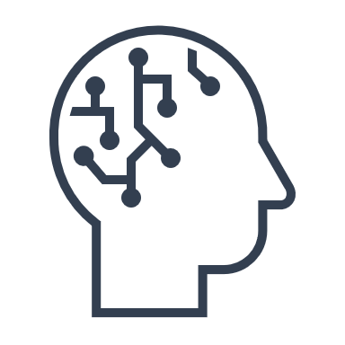








Libraries and Museums Provide Tremendous Support for:
Workforce Development
Improving Reading Skills
Veterans
Local Schools/Education
Home Schooling
AI Literacy
Tourism Revenue
Small Businesses/Entrepreneurs
Senior Citizens
Financial Literacy
Trades
Cultural Heritage & Patriotism
Rural Connectivity
Certifications

Slide 4





Pillars of Educational Support Ideally Situated to Support States-Centered Education
Libraries and Museums serve as essential educational partners, perfectly situated to support the new age of state-centered education in line with the needs and goals of our local communities and schools.
Literacy Development
Early reading programs, summer reading challenges, and specialized literacy resources help improve reading proficiency across all age groups and demographics.
Academic Achievement
Libraries provide homework help, research databases, and tutoring programs that directly support curriculum goals and student success at all educational levels.
Digital Literacy
Technology access, digital skills training, and online learning opportunities bridge the digital divide and prepare communities for an increasingly digital world.
Lifelong Learning
From early childhood programs to senior education initiatives, libraries create inclusive spaces for continuous learning that complement formal education systems.
Studies show communities with well-funded libraries consistently demonstrate improved educational outcomes and higher academic achievement rates.

Slide 5





Centers for Workforce and Small Business
Digital Literacy
Free computer access and technical training
AI Education
32% of librarians report need for AI training
Trade Skills
78% provide job services; 24% offer workforce development
Certification Prep
Free resources for SAT, GED, CDL, HVAC, IT certifications
Co-Working and Business Support
40% increase in room reservations since 2019

Slide 6



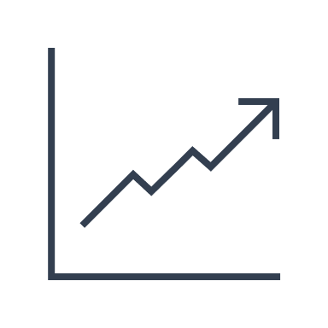


Museums: Local Economic Support, Tourism & Cultural Impact
Cultural Tourism
76% of leisure travelers engage in cultural activities
"Museums are not only essential for the enrichment of society, but they are also economic catalysts. They attract millions of tourists and provide numerous jobs."
– John Paulson
Higher Spending
Cultural tourists spend 60% more than other travelers
Market Growth
Museum industry reached $18.1B in 2024
Community Enrichment
Cultural hubs strengthen local identity
Tax Revenue
Each new Museum job results in $16,495 in additional tax revenue

Slide 7
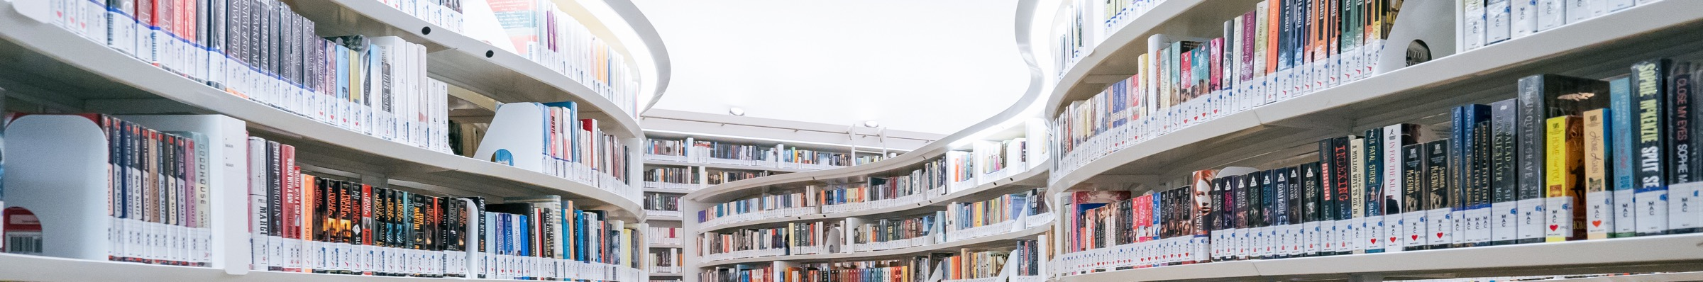




Libraries: Fiscal Responsibility & Resource Sharing
Cost-Effective Resource Sharing
Example: MeLCat saves Michigan libraries $26.5M annually
Consortia Purchasing Power
Academic collections worth millions available at fraction of cost
Rural Community Access
77% of rural communities rely on libraries for internet
Economies of Scale
Shared resources and at-scale deliverables multiply impact of federal dollars

Slide 8
National Impact: High Return on Investment
Museums
Libraries
$50B
$5+
Economic Contribution
ROI
Annual museum contribution to US economy
Return for every dollar invested in libraries
$12B
67,094,857
Tax Revenue
Library Visits in 2022
Generated by museums annually
People using physical public library resources and programs
726K+
39%
Jobs
Increased Demand for e-Resources
Positions supported by museums nationwide
Rise in total online resources accessed in 2023 compared to 2019

Slide 9

Federal Grants in Action
Science of Reading
Rural Connectivity
Toledo librarians trained in essential reading skills
Whitefish Library: 12 Mbps to 522 Mbps internet speed
Entrepreneurship
Heritage Preservation
Gwinnett County's New Start program for formerly incarcerated
Germantown Library conserving 1719 German Luther Bible
Home School Education Support
Future-Ready Communities & AI
Choctaw County Library System is creating educational
kits for homeschool families based on parent input
University at Albany examining how libraries can empower
communities to better understand Artificial Intelligence

Slide 10






Our Ask: Invest in America's Future
$311M by 2026
$1 per US citizen
$266.5M Now
Maintain current funding
(Library & Museum Services)
Multiply Impact
Every $1 returns $5+ to communities
Libraries and museums are economic drivers, educational assets, and cultural cornerstones that align with key legislative priorities.

Slide 11
Sources
https://www.ala.org/sites/default/files/pla/content/data/PLA_Services_Survey_Report_2023.pdf;
https://www.ebsco.com/blogs/ebscopost/how-libraries-help-job-seekers-get-hired;
https://crl.acrl.org/index.php/crl/article/view/26409/34344;
https://www.ebsco.com/blogs/ebscopost/public-libraries-job-career-services-skilled-trades
https://americanlibrariesmagazine.org/2024/11/01/by-the-numbers-small-business; https://www.bayonnelibrary.org/five_ways_local_libraries_can_help_small_businesses_and_entrepreneurs;
https://www.dallascitynews.net/dallas-b-r-a-i-n-promotes-entrepreneurial-literacy-and-local-business-development
https://www.aam-us.org/;
https://www.lrs.org/data-tools/public-libraries/return-on-investment/recent-studies/;
https://www.aam-us.org/programs/about-museums/museum-facts-data/
https://www.lrs.org/data-tools/public-libraries/return-on-investment/recent-studies/
https://www.aam-us.org/programs/about-museums/museum-facts-data/
https://medium.com/everylibrary/the-return-on-investment-from-your-public-library-is-unbelievable-93603caac530
www.bayonnelibrary.org/five_ways_local_libraries_can_help_small_businesses_and_entrepreneurs?
https://americanlibrariesmagazine.org/2024/11/01/by-the-numbers-small-business/
https://d2ujpqfu85jxzw.cloudfront.net/website/panth-live/2025-01/2024-Economic-Impact-Statement.pdf
www.urbanlibraries.org/files/2024-ULC-Library-Insights-Report.pdf

